Slide 1
Pseudoreplication: How to avoid it in experimental design and analysis
Developed by Desirée De Leon & Hasse Walum
Data Science Talk
Oct 15, 2018
Notes:
Pseudoreplication is a statistical concern that affects a large amount of biomedical research, and is relevant to our research in this lab. it is important to be aware of because it may change the way you analyze your data and affect the conclusions you draw. Knowing what it is will also help you better evaluate your own experimental designs and that of other researchers.

Slide 2



The P-value
The probability of getting your experimental result (or something more extreme), given that the null hypothesis is true.
NOT: The probability that the null hypothesis is wrong
P = 0.65 means a 65% chance that you would get the data you did (or something more extreme), if there is no true difference between groups.
NOT: The probability that the your hypothesis is wrong
Notes:
Pseudoreplication will affect our p-values, so it’s important to first refresh our memory about what the p-value actually is:
The probability of getting your experimental result (or something more extreme), given that the null hypothesis is true. To put it more simply, what is the likelihood that you would have gotten the results you did (or greater) if there were no REAL group differences?
It is NOT an indication of the probability that the null hypothesis is wrong, or worse, it is NOT the probability that your hypothesis is incorrect.
Here’s an example: Observing a difference between a control group and a drug-treated group with a p-value of 0.65 means that there is a 65% chance you would observe this difference (or something more extreme) without there being any real difference between the groups.

Slide 3

Can you trust your p-value?
Assumption: Observations cannot be correlated (they must be independent) for our inferences to be correct
2
1
3
Pseudoreplication occurs when data points are not independent but treated as if they are
Notes:
Desiree:
So, now that we’ve had a p-value refresher, an important question is whether or not we can trust our p-value.
For most of the models that we use ( like ANOVA, t-test, ordinary least squares regression) we can only trust our p-value if our observations are independent, meaning that the observations must not be correlated with each other in order for our inferences to be correct. Only then is our p-value reliable.
Pseudoreplication occurs when we violate this principle by taking data points that re NOT independent and treating them as if they are in our statistical tests.
Let’s start with an extreme example of pseudoreplication.

Slide 4
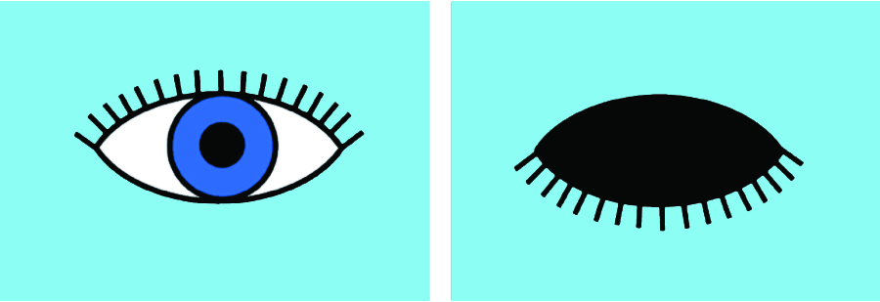


Extreme example of pseudoreplication
N=10
N=5
N=5
Notes:
Desiree:
Let’s say you were doing an experiment that tested whether there were any sex differences between the blink reaction times to an air puff.
You want to record 5 observations for each sex, for a total of 10 observations. But instead of getting a single observation from 5 different males and females, you record the same male or female’s individual’s reactions 5 times.
What you see to the right is a simulated, hypothetical outcome of this experiment.
All of your observations within each group will be obviously highly correlated.
Whatever p value you get from this analysis will be unreliable if you treat this as a total N of 10.
What you really have is much smaller effective number of independent observations, and if you correctly acknowledge this much smaller sample size, your test statistic and p-value will be very different.

Slide 5
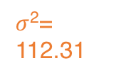
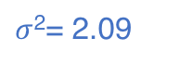
Determining the effective sample size, N
Intraclass correlation (ICC)
σ²_{between.group}
112.31
Between
group
ICC = =
σ²_{between.group}+ σ²_{within.group}
112.31 + 2.09
Within group
$σ$²= 112.31
$σ$²= 2.09
= 0.98
design effect = 1 + (n − 1) × ICC
= 1 + (5 − 1) × 0.97 = 4.93
N_{effective} =
N × n
= 2 x 5
= 2.03
design effect
4.89
Notes:
Hasse:
From this example, it is obvious to see that there are only two independent subjects. But we can confirm this in a mathematical way.
You can calculate a corrected/ effective sample size by figuring out how correlated observations are within a group.
the degree of similarity within each group is called the intraclass correlation (ICC).
You can calculate the variance between and within groups, and putting those values into the ICC equation, it will spit out the value representing how similar your obs are within the same group.
The ICC can be interpreted similarly to Pearson’s correlation coeff (except restricted to positive).
When we calculate the ICC for this experiment, we see it is very high (97%).
This can in turn then be plugged into another equation for the design effect, which allows us to calculate the factor by which we should adjust our N.
Finally, we can take the total number of observations, correct by the design effect, and get a read-out for our corrected sample size.
We see here that it is basically 2, which was the # of individuals we started with.

Slide 6
Markdown for calculating the ICC

Slide 7

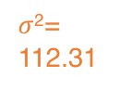
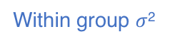
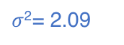
Determining the effective sample size, N
Intraclass correlation (ICC)
σ²_{between.group}
ICC =
σ²_{between.group}+ σ²_{within.group}
Between group $σ$²
Between
group
Within group
Within group $σ$²
$σ$²= 112.31
$σ$²= 2.09
Notes:
The example we just walked through was good for walking through how the ICC is calculated. But it’s a bit of a non-sensical example because there was only one cluster per sex. So from that example, it would be difficult to disentangle a true effect of sex on eyeblink reaction time from the effect of just being clustered.
The plot on the right illustrates how even with more individuals per sex, you can see that with a high ICC value, the individual observations will cluster. And the ICC will be calculated in the same way.

Slide 8
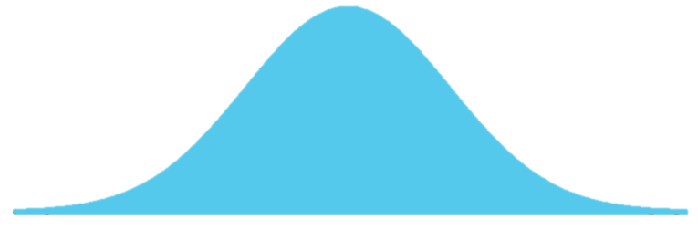
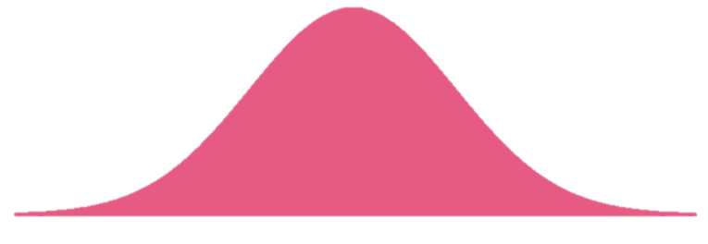
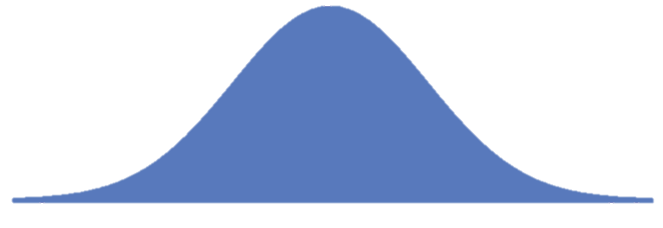
Why is pseudoreplication a problem?
Study p-values
1 0.67
2 0.04
3 0.24
. .
. .
. .
µ
µ
N=10
N=10
Repeat 1000x
save
p-value
statistical test
Notes:
Desiree: So what are the consequences of this?
If we tell our statistical model that we have a larger N of independent replicates than we do, we are fooling our model into thinking that is has more information than it really does. This leads to a problem that I’d like to illustrate through an example with a simulation.
The point of simulation is to generate data with known parameters (we set the mean, variance, etc.) and to then give it to our statistical model and see how good of a job it does at giving us back the right answer.
Let’s start by going through the steps of a simulation, leaving Pseudorep aside for a bit:
- We will simulate a scenario where there is no true treatment effect between two groups. To make this example more concrete, let’s say that this happens when we have a pink control and blue treatment group of animals, but we mistakenly give both groups saline, instead of giving the experimental group a drug treatment.
Imagine you have a situation where you have two different populations of animals. A “pink” control population that represent the animals that will get saline, and a blue population that represents the animals that you intend to give a drug treatment to.
You randomly will sample from this population.
BUT, you mistakenly give both the pink and blue animals saline---so in reality there is no difference between these two populations. Though you think you’re sampling from the blue and pink populations, you’re really just sampling twice from the same population.
In an ideal world, when you compare your two samples with a statistical test, the p-value you get should not be significant here over and above chance (which, if you used an alpha of 0.05, that chance = 5%).
Since this is a simulation, we can repeat this scenario all over again, do a statistical test, save the p value. Might occasionally get a significant p-value due to chance.
And we can simulate a third study, all the while keeping track of the p-values.
We can repeat this 1000x and see what % of the 1000 experiments did we get a low/ statistically significant p-value.

Slide 9
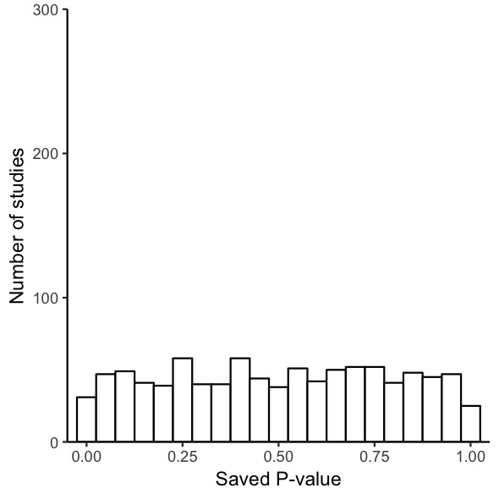
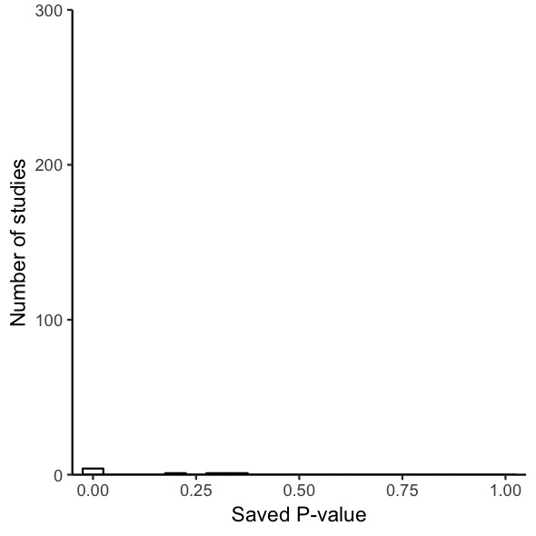
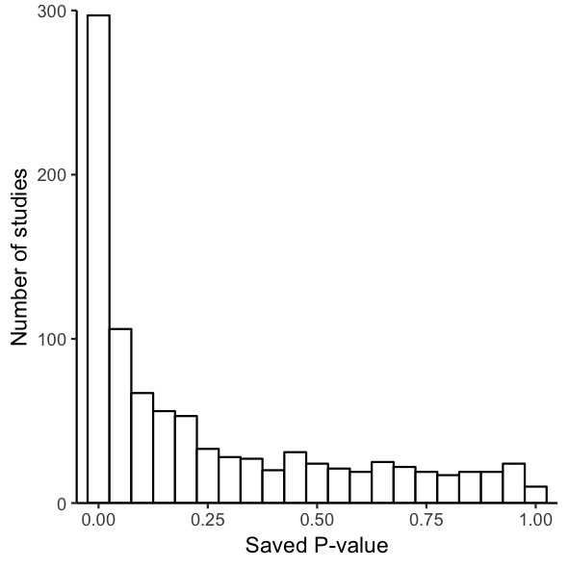
Why is pseudoreplication a problem?
Study p-values
1 0.67
2 0.04
3 0.24
. .
. .
. .
µ
N=10
N=10
Repeat 1000x
save
p-value
statistical test
Notes:
Desiree:
We can track the frequency of particular p-values with a histogram, represented to the right.
Each additional simulation adds one more p-value to the histogram.
The very first bar in the histograms represent p-values that are < 0.05.

Slide 10
Why is pseudoreplication a problem?
Study p-values
1 0.67
2 0.04
3 0.24
µ
. .
. .
. .
N=10
N=10
Repeat 1000x
save
p-value
statistical test
Notes:
Desiree:
We can track the frequency of particular p-values with a histogram, represented to the right.
Each additional simulation adds one more p-value to the histogram.
The very first bar in the histograms represent p-values that are < 0.05.
In a situation where the animals from this saline experiment were all independent observations, we expect to see a histogram like the one on the top: with each p-value from 0-1 being equally likely to occur.

Slide 11
Why is pseudoreplication a problem?
Independent
Independent sampling
vs
Pseudoreplication
µ
µ
N=10
N=10
N=10
Pseudoreplicated
N=10
save
p-value
save
p-value
statistical test
statistical test
Notes:
However, in a situation where our samples are correlated in some way and there is uncorrected pseudoreplication, we get a histogram like the one on the bottom.
Even though the pink and blue groups are being sampled from the SAME population, and there is NO REAL POPULATION DIFFERENCE between these two groups, we are getting nearly 40% of our results to show statistically significant results. THESE ARE FALSE POSITIVES.
This is a scenario in which getting a low p-value is not good!!
answers the question: if we design an experiment with pseudoreplication, how many times will we incorrectly reject the null hypothesis, aka star to report significant results where there should not be any.
This increased risk of false positives is one of the reasons pseudoreplication is a problem

Slide 12
Markdown for false-positive simulation
Notes:
This is what happens when we sample from populations with the same mean and the same, and there’s not between group variance ghat will allow observations to cluster.

Slide 13
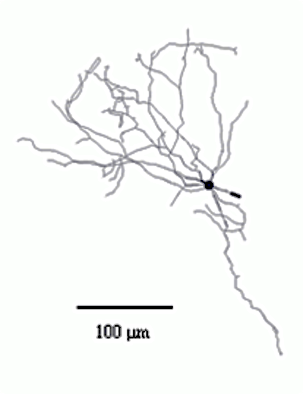
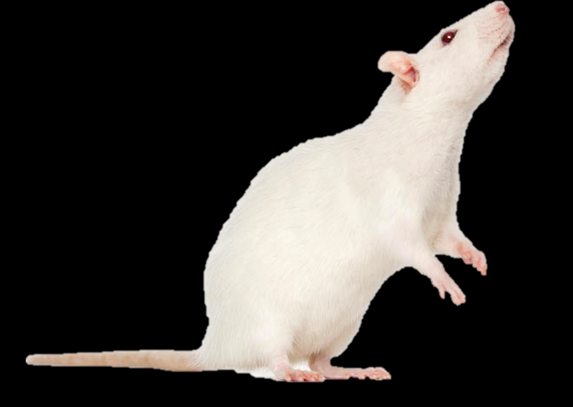
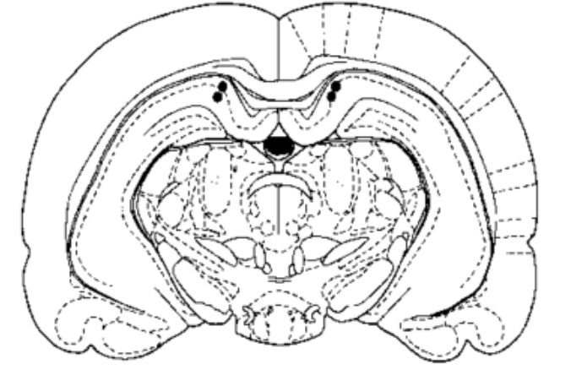
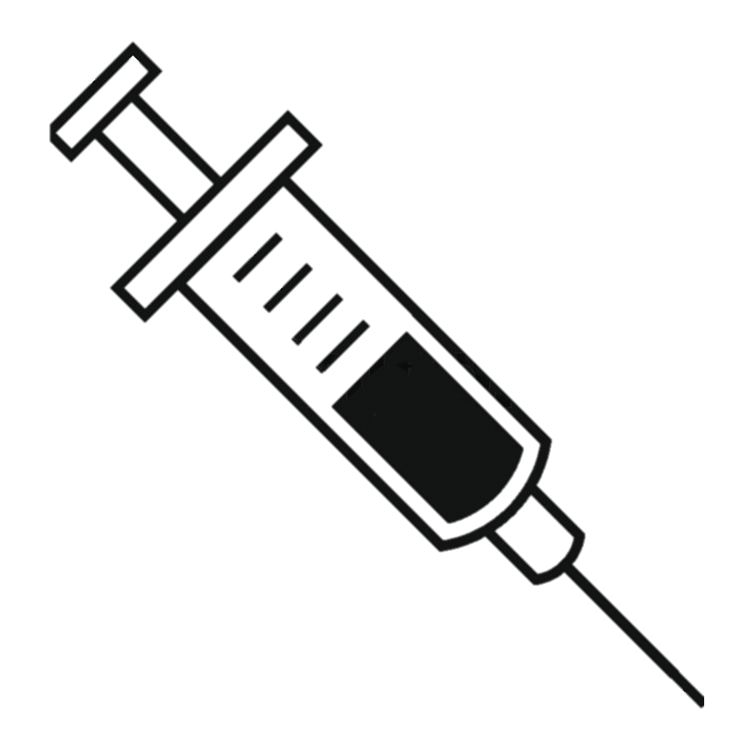
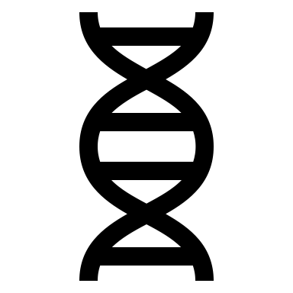
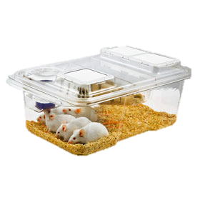
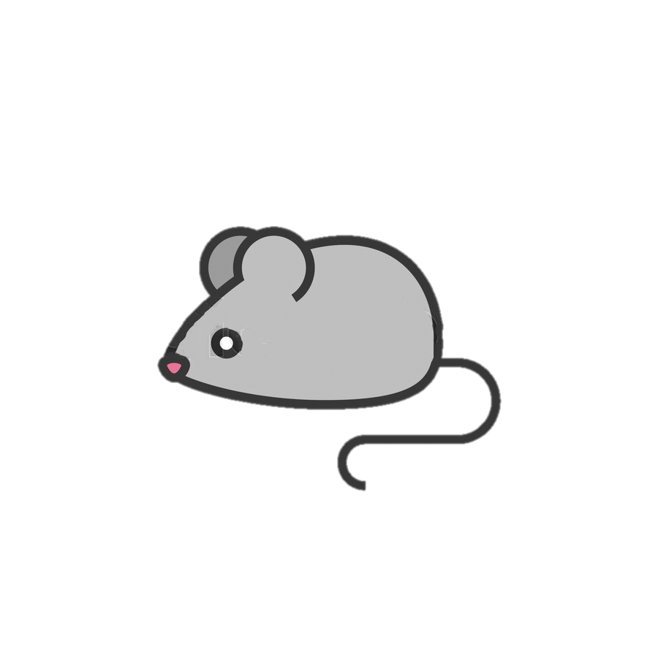
Common designs with pseudoreplication
Samples from different levels of biological organization
X 100
Control
vs.
Prenatal environment
Animals within a litter or other groupings are not independent
Notes:
Hasse: Now that you have a sense for why pseudoreplication poses a problem, let’s identify a few common scenarios where pseudoreplication can occur.
First up are samples that come from different levels of biological organization. Consider an experiment with 2 experimental conditions (Control vs Treatment), with one rat in each condition.
The outcome variable is the number of dendritic arbors on cells in the CA3 region of the hippocampus, and 100 cells are examined in each rat. This would give 2 rats × 100 cells per rat = 200 data points.
The incorrect way to analyze this data is with a t-test with an n of 200.
This is incorrect because ***Cells within rats will tend to be more similar than cells between rats and therefore are not independent of each other.
Including all of the 200 data points in the analysis as if they were independent gives a false estimate of the precision. Two rats will never be exactly the same and therefore it is simply a matter of taking enough measurements on two rats to show that they are statistically different.
Similarly, animals within litter are not independent because b/c:
They share the same Parents
Same prenatal environment
epigenetic and developmental factors may play a role, and two rats from the same litter are likely to be more similar than two rats from two different litters
In addition to these biological factors, other conditions such as caging could result in animals in in the same cages being more similar than animals across cages.
Any other grouping of data points: applying treatments to cages of rats rather than individual rats (e.g. administering a substance in the drinking water), or applying treatments to pregnant females but examining the effect in the offspring. Here, cage and pregnant females are the experimental units, and not the individual animals since the treatments can only be applied to whole cages and pregnant females and not to the individuals animals.

Slide 14

What can you do?
Recognizable subgroups
Control Treated
Litter 1
2
Litter 1
Treatment applied independently and no spillover
Litter 2
Litter 2
Randomized independently to groups within subgroups
1
Adapted from Lazic et al. 2018
Notes:
Hasse: In many instances, pseudoreplication can be dealt with prior to analysis, for example in the design stage by randomizing animals from the same litter or group to different treatments.

Slide 15

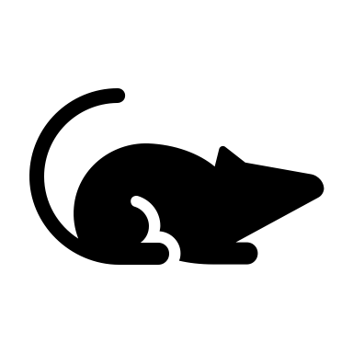
Example: Valproic acid (VPA) model of autism
CONTROLS
Dams
Litters
N =
2
2
4
5
6
7
2
2
4
5
6
7
Controls: Total N=26
Treated: Total N=26
Notes:
Desiree:
- In some cases, you cannot randomize individual offspring to different treatment groups because an experimental treatment can only be applied to whole litters.
- An example is the valproic acid (VPA) model of autism that we’re all familiar with, where VPA is given to pregnant females and the effects of the treatment are then measured in the offspring.
- With this type of experiment the sample size is the number of litters and not the total number of offspring. If such experiments are not appropriately designed and analyzed, the results can be severely biased as well as extremely underpowered.
Main points:
#1) We can’t randomize
#2) And as we’ve shown, we can’t treat individual offpsirng as independent observations

Slide 16
VPA Example: Wrong vs Better way
The Wrong Way
N=52 animals total (26 vs 26)
6 litters of N= 2,2,4,5,6,7 per group
P= 8.79 x 10⁻⁵
The Better Way
N=12 animals total (6 vs 6)
Unit of analysis is the litter
P= 0.017
CONTROL
CONTROL
Notes:
Desiree:
These graphs show a dataset that we simulated for this VPA scenario.
Here we should 6 litters that came from control dams, and 6 litters that came from dams treated with VPA. The hollow circles represent individual offspring in the litter.
And on the Y axis, we have each offspring’s mean score on an outcome relevant to the autism phenotype.
If we analyzed each offspring as an independent ob w/ 26 per group, the differences between the two groups would appear to be extremely robust with an extremely low p-value.
The better way to analyze this data is to take the AVG of each litter, using an N of 6 per group, thus eliminating any litter effects. And your p-value would represent a more realistic estimation of the effect.
When we calculate the ICC for this experiment, it is 0.80 (still pretty high) and consequently, when we correct the sample size, we would get an effective sample size of N= 14 per group, instead of the N=26 that we started with.

Slide 17
Markdown for VPA example

Slide 18
The downside to discarding the information about litter size
Using Average per Litter
Taking into account variability in litters
CONTROL
CONTROL
Notes:
Desiree:
Averaging has the advantage of simplicity, and common statistical tests can be applied (e.g. t-test, ANOVA).
A drawback is that information is lost when averaging; for example, there may be a different number of animals for each litter, and the observations for some litters might be more variable than for others.
Therefore, with an average, some estimates of the mean response for each litter are more precise than others
The error bars here on the graphs at the right, show the averages with the SEM. The error bars show the information that we’re ”throwing away” when we only use the average.

Slide 19
Code for plotting average values with SEM
Generating the SEM
Plot with SEM as “arrows”

Slide 20
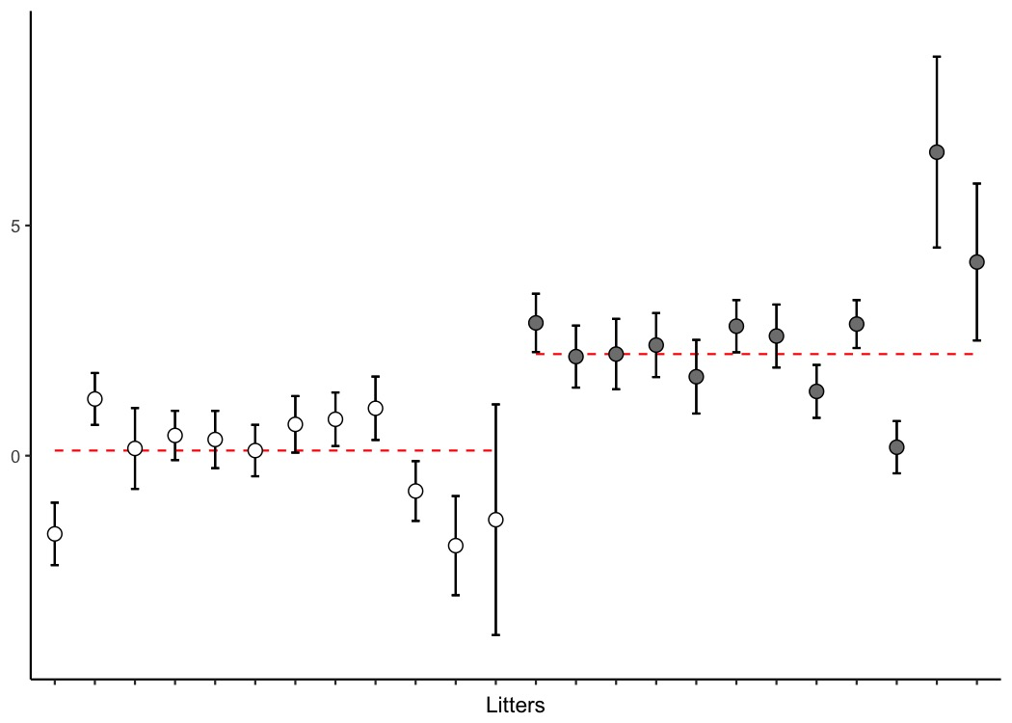
Correcting with a mixed model
Flexible modeling framework
Compromise between individual
and group level analysis
Uses group level info to shrink
estimates toward grand mean
Notes:
Hasse:
one solution is using a mixed model
benefit is that it appropriately shrinks outcome values based on the uncertainty, the error, and how far away the litter averages are from the grand mean of all the litters in that group

Slide 21
Correcting with a mixed model
Flexible modeling framework
Compromise between individual
and group level analysis
Uses group level info to shrink
estimates toward grand mean
Notes:
Hasse:
one solution is using a mixed model
benefit is that it appropriately shrinks outcome values based on the uncertainty, the error, and how far away the litter averages are from the grand mean of all the litters in that group

Slide 22
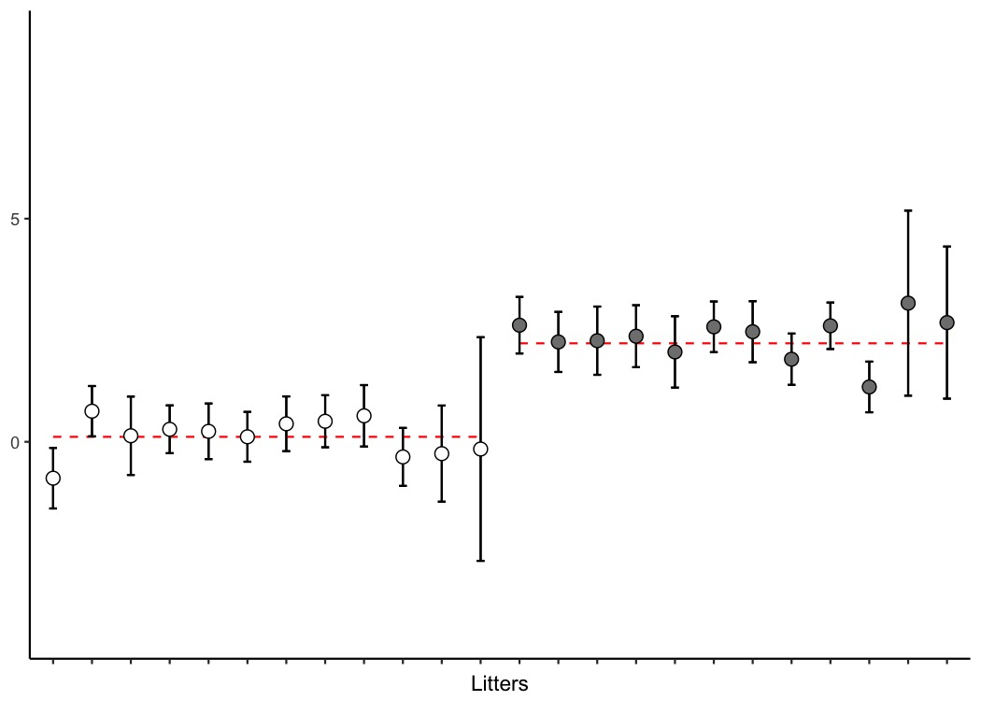
Correcting with a mixed model
Flexible modeling framework
Compromise between individual
and group level analysis
Uses group level info to shrink
estimates toward grand mean
Notes:
Hasse:
one solution is using a mixed model
benefit is that it appropriately shrinks outcome values based on the uncertainty, the error, and how far away the litter averages are from the grand mean of all the litters in that group

Slide 23
Mixed Model: R function lme()

Slide 24
Revisiting the VPA example
Using Average per Litter
After shrinkage
P= 0.017
P= 0.045
CONTROL
CONTROL
Notes:
If we revisit the VPA example, we see that the graphs on the left show the averages for each litter.
The red dotted lines represent the grand mean for either the control or treated group.
We can also see the p-value associated with the differences between the control and treated groups.
If we put this data into a mixed model, it will take the litters with the most amount of “uncertainty” and pull them in slightly towards the grand mean.
The overall outcome using these adjusted values gives you a p-value that is slightly lower than using the average per litter.

Slide 25
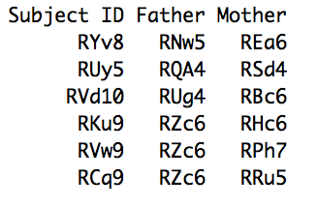
Pseudoreplication and Relatedness
Can use Pedigree information as a random effect in mixed model
Notes:
As a final example, whether you’re using rodents, primates, or human subjects in your studies. If you have related individuals, even of varying degrees of relatedness, this is something that we can take care of statistically with a mixed model.
More genetically similar individuals are likely to have more similar traits than less genetically similar individuals.
1) we have a limited number of breeder pairs, so it may not always be possible to randomize animals to different treatment groups without using more than 2 animals per litter. There may not be enough animals for the experiment this way.
2) In addition to having a limited number of breeders, we also have animals that were recently very inbred….so most animals from separate litters actually are not completely unrelated.
- Just pay attention to which animals you use and which breeder pairs they come from, so that we can account for this later.

Slide 26
CONCLUSIONS
Ignoring pseudoreplication leads to increased likelihood of false positives
Correlated observations must be accounted for
Randomize
Look at your data, calculate the ICC
Take the average
Use a mixed model
2
1
3
Notes:
HASSE:
Random notes below:
Pseudoreplication does not necessarily imply that the studies are flawed, and a reanalysis of the data may be all that is required. It may however become apparent that the sample size is too small to make any meaningful inferences about the parameters of interest.
- But for many situations, you can
- remedy the issue by making sure animals end up in different treatment group. then you don’t have to worry about correlated stuff at all.
can use paired t test, and actually gain power.
THEN AT LEAST BE AWARE THAT RELATEDNESS CAN BE CORRECTED FOR.
In some cases you can just plan without wasting animals. When you have to use cagemates, you can randomize…. #2
Measuring something 100x in just one animal is NOT going to give your statistical model much more information. So this is NOT a solution
Dendritic arbor example: take an average.
LOOK AT YOUR DATA: divide the data up in the groups that you’re actually analyzing. Calculate the ICC
It’s possible that you got 100 cells from an animal and there is so much unexplained Var that it doesn’t cause a problem….But you don’t know that until you’ve looked.
Similarly, it’s a bad idea to assume that your observations are independent. And it’s also bad to assume to that they are highly correlated. Needs to be tested empirically.
When possible, plan your experiments to avoid this issue all together.

Slide 27
Group’s mean
Grand mean
Individual
Observation
Group mean
(M or F)

